Slide 1
MULTIPLE BREAK REBAR
Advisor : Prof. K.C.Chang
Presenters : You-Ran Nai

Slide 2
OUTLINE
QUESTION REPLY
PAPER PROGRESS
PAPER REVIEW

Slide 3
Incremental Dynamic Analysis with Multi-Modes for Seismic Performance Evaluation of RC Bridges
Prakit Chomchuen, Virote Boonyapinyo
Engineering Structures
February 2017

Slide 4
AUTHOR
UNIVERSITY
Prakit Chomchuen, Virote Boonyapinyo
Department of Civil Engineering, Faculty of Engineering, Thammasat University, Rangsit Campus, Klong Luang, Pathumthani 12120, Thailand

Slide 5
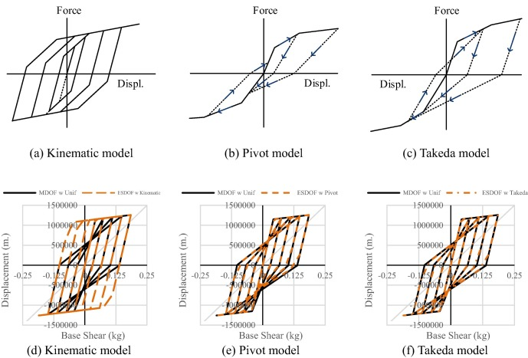
HYSTERESIS
Notes:
遲滯迴圈的模擬用程式內建的參數並不太準
對，paper 是使用模型自動產生的參數

Slide 6
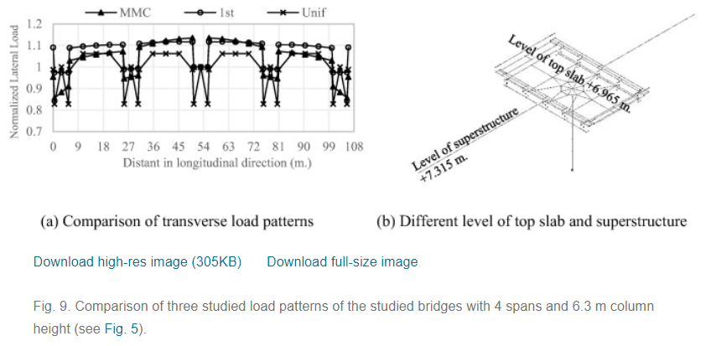
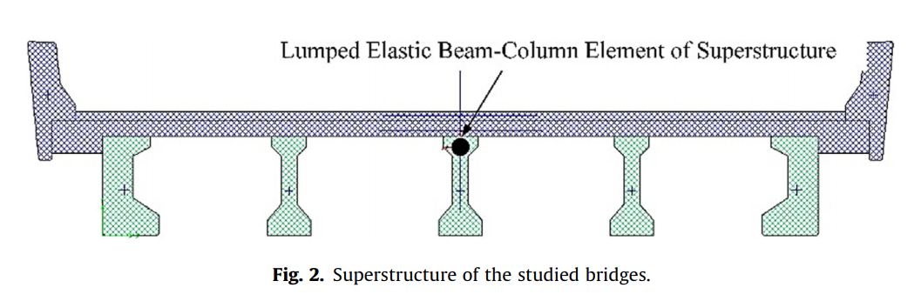
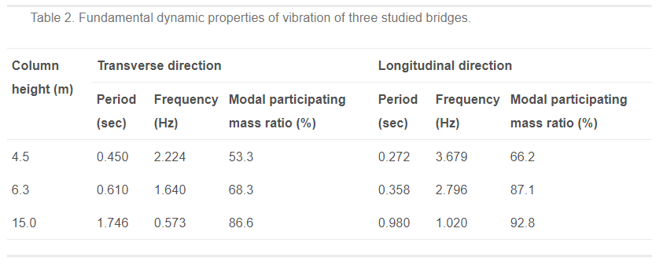
THREE BRIDGES

Slide 7
Incremental dynamic analysis
Dimitrios Vamvatsikos and C. Allin Cornell
EARTHQUAKE ENGINEERING AND STRUCTURAL DYNAMICS
2002
Notes:
Department of Civil and Environmental Engineering; Stanford University; CA 94305-4020; U.S.A.

Slide 8
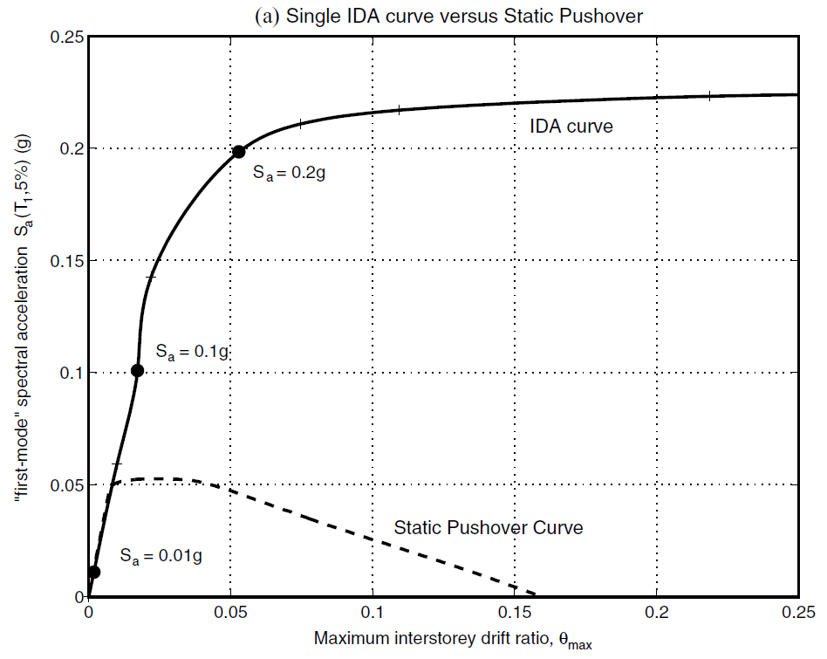
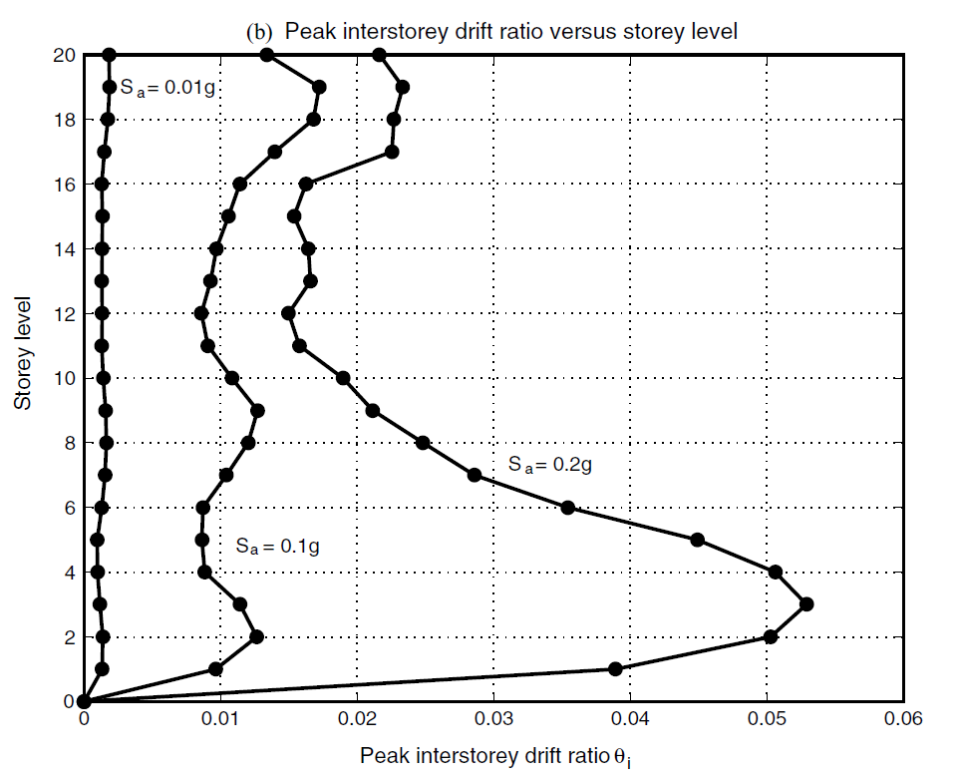
INTRODUCTION
SINGLE STATIC ANALYSIS
➔
INCREMENTAL SPO
SINGLE TIME-HISTORY ANALYSIS
➔
INCREMENTAL ONE

Slide 9
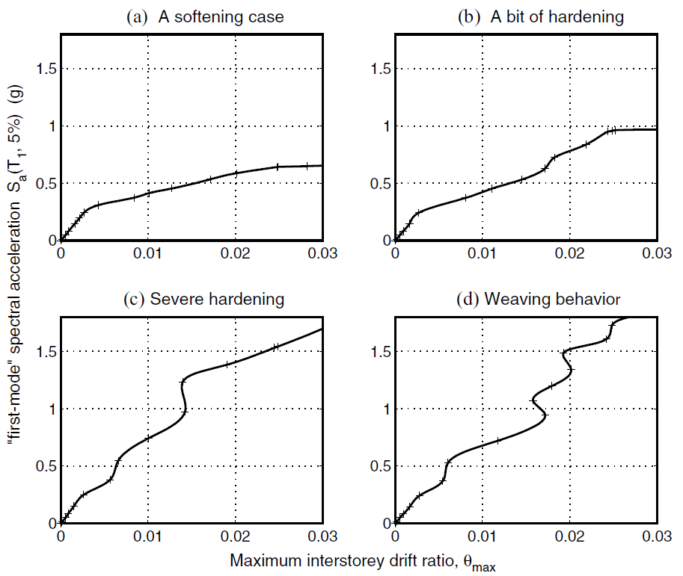
INFINITY
SOFTENS
0.2g
？
SOFTENING
&
HARDENING
EQUAL DISPLACEMENT
0.2g
Notes:
SOME GENERAL PROPERTIES

Slide 10
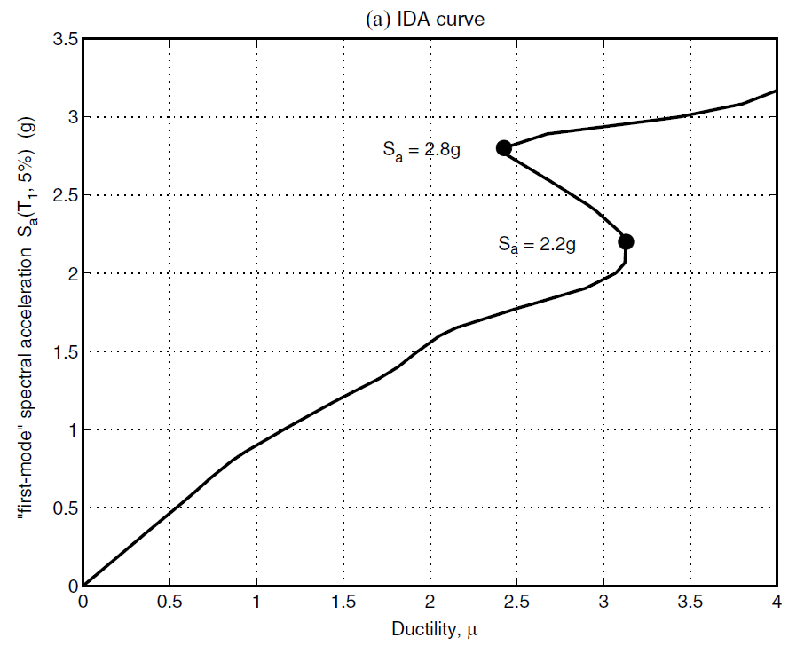
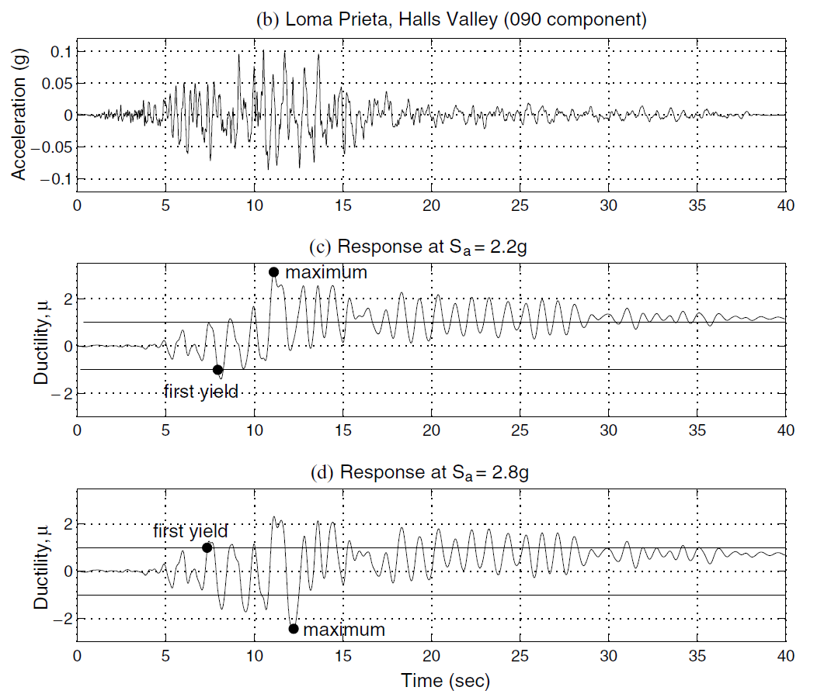
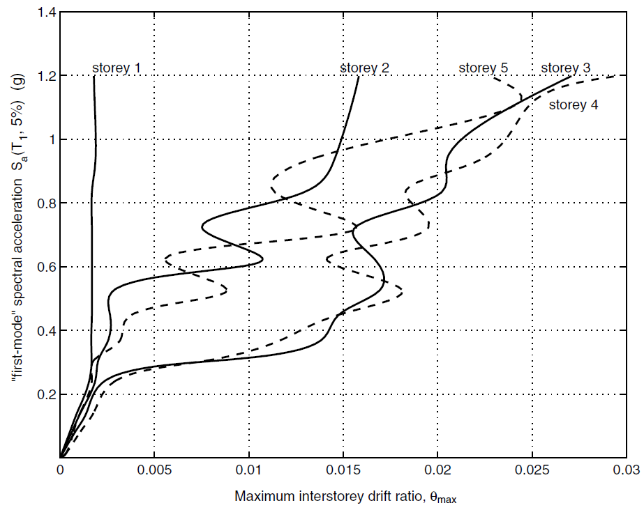
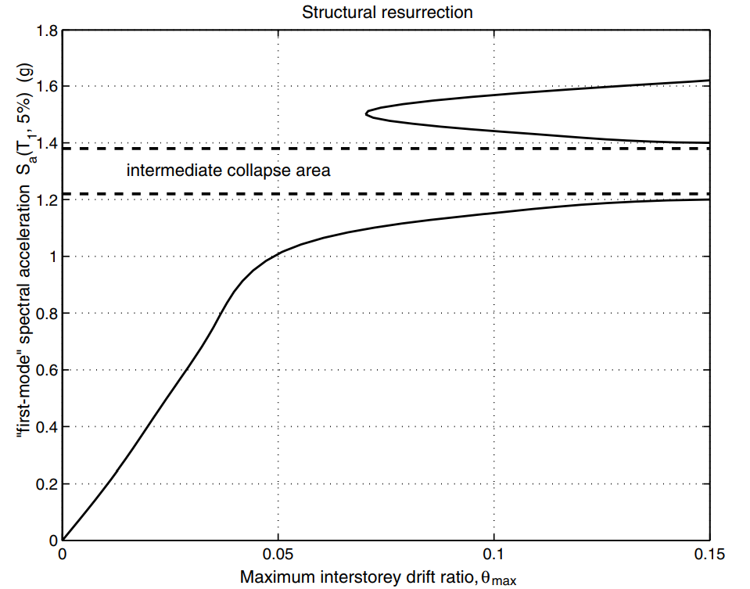
EARLIER YIELDING
FUSE
STRUCTURAL RESURRECTION

Slide 11
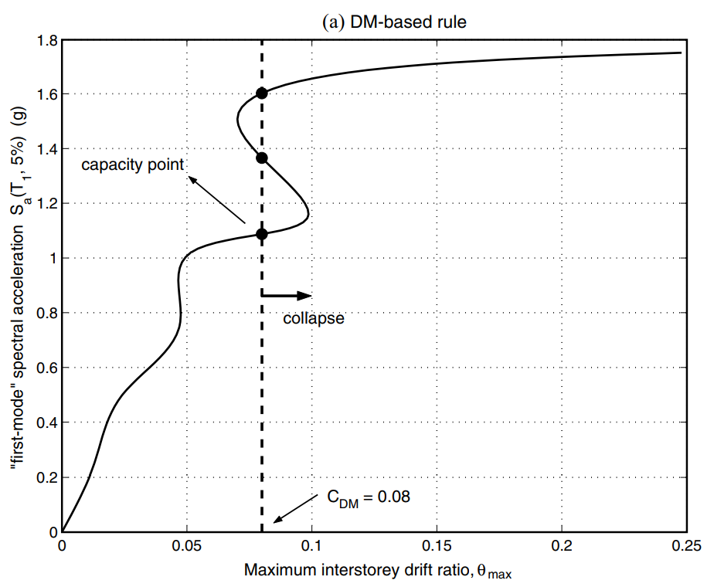
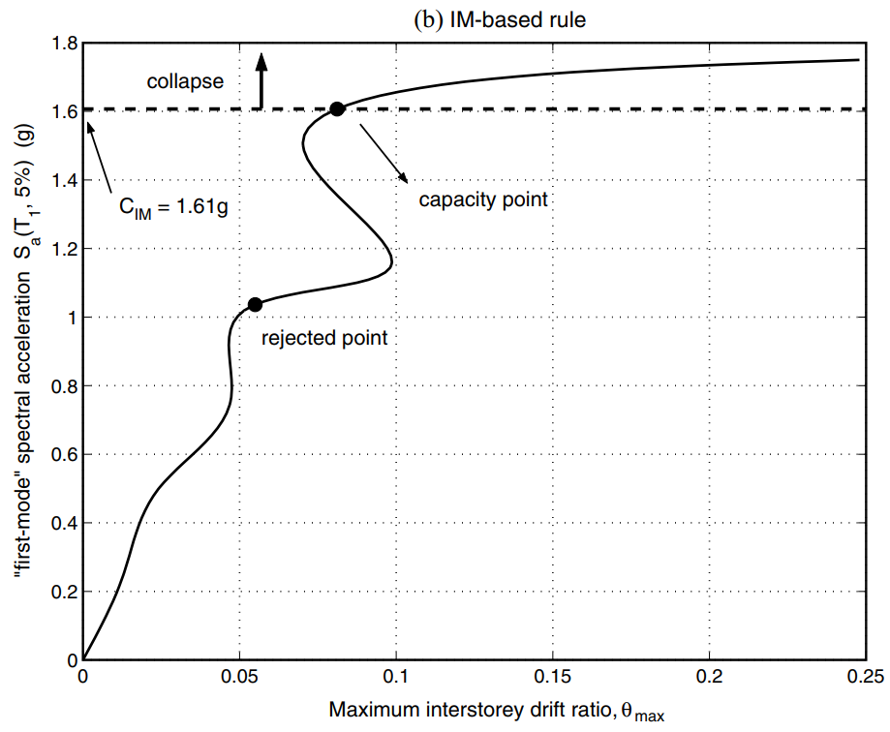
CAPACITY AND LIMIT-STATES
FEMA 20% TANGENT SLOPE APPROACH
Notes:
CAPACITY AND LIMIT-STATES

Slide 12
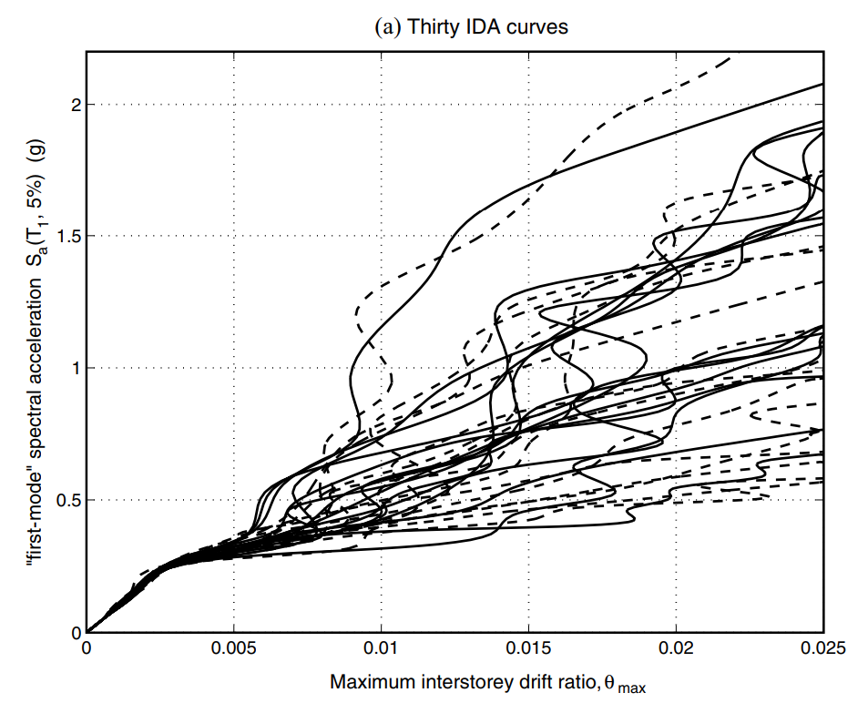


MULTI-RECORD
PARAMETRIC METHODS
NON-PARAMETRIC METHODS
MEAN MEDIAN
CAPACITY

Slide 13




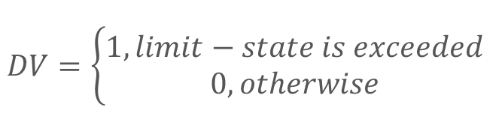

PBEE FRAMEWORK
$$DV=\left\{\begin{aligned}1, limit−state is exceeded \\ 0, otherwise\end{aligned}\right.$$
$$λ\left(IM\right): hazard curve$$
$$G\left(DM | IM\right):(conditional) complementary cumulative distribution$$

Slide 14
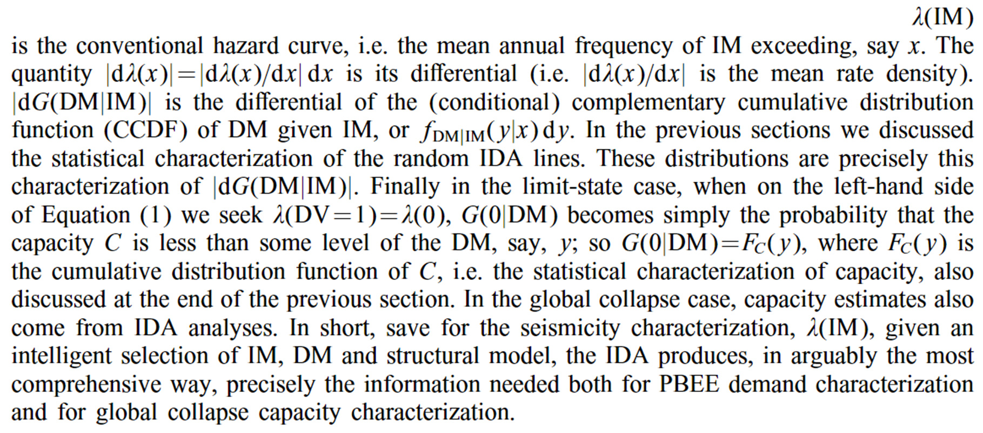

Slide 15
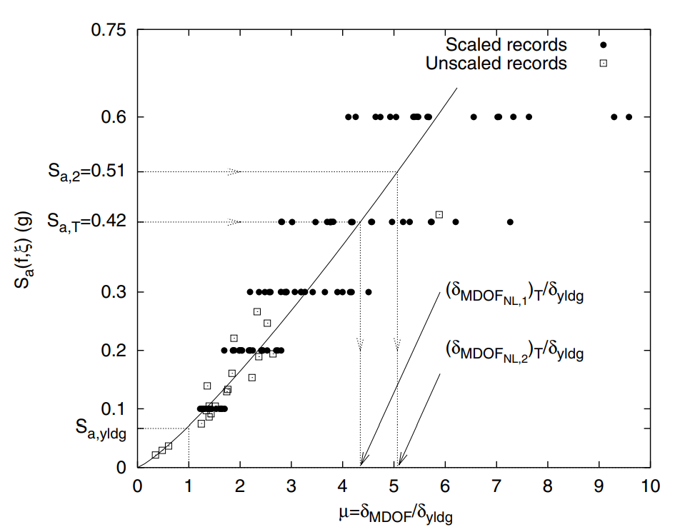
SCALING LEGITIMACY
ROOF DUCTILITY RESPONSE OF A
T₁= 1s
MDOF STEEL FRAME SUBJECTED TO
20 RECORDS
SCALED TO 5 LEVELS OF Sa(T₁,5%)

Slide 16
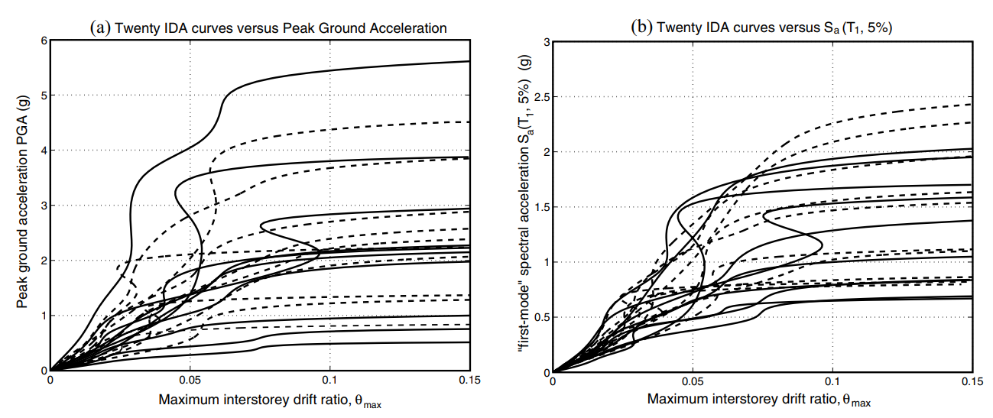
PGA
Sa(T₁,5%)

Slide 17
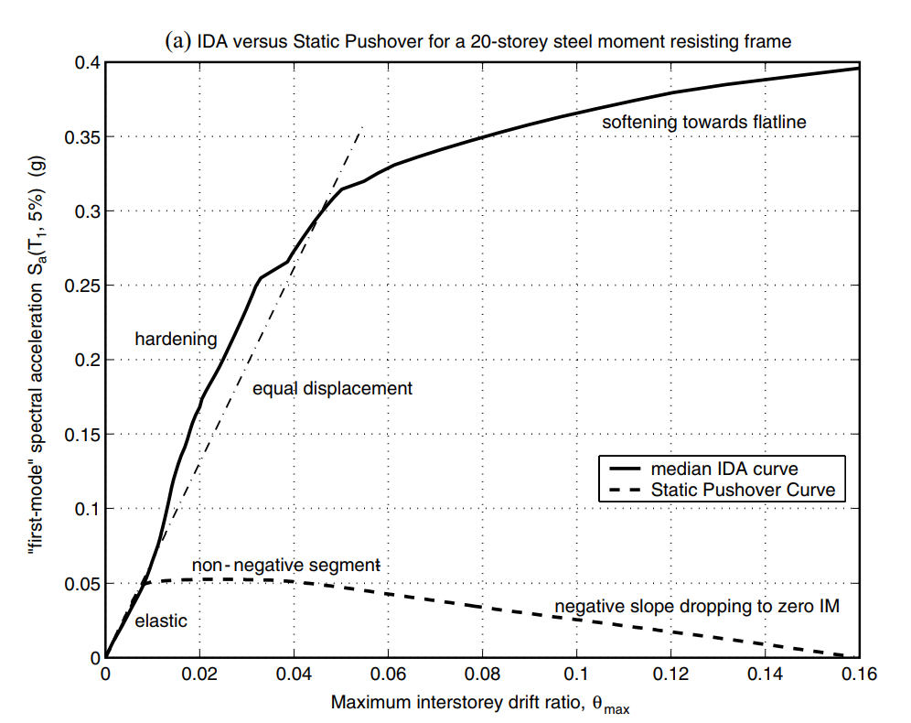
NON-LINEAR SPO
ELASTIC
➔
MATCH
NON-NEGATIVE
➔
EQUAL DISPLACEMENT
NEGATIVE
➔
SOFTENING

Slide 18
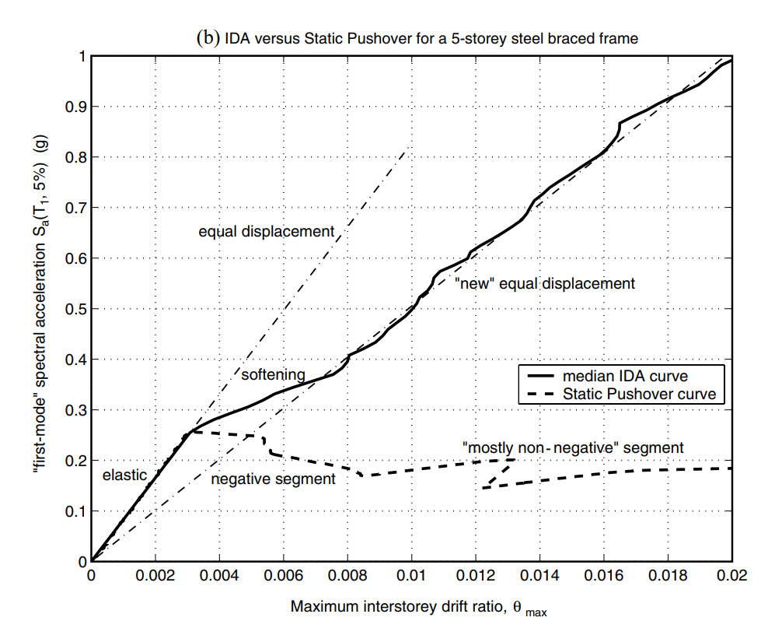
NON-LINEAR SPO
NEGATIVE => NON-NEGATIVE
NEW
EQUAL DISPLACEMENT
➔

Slide 19
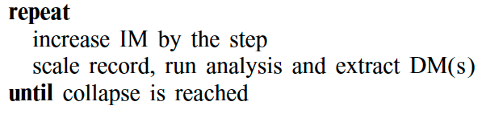
IDA ALGORITHMS

Slide 20
IDA ALGORITHMS

Slide 21
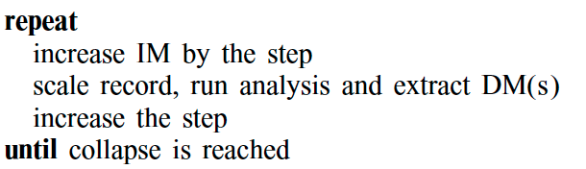
HUNTING PHASE

Slide 22
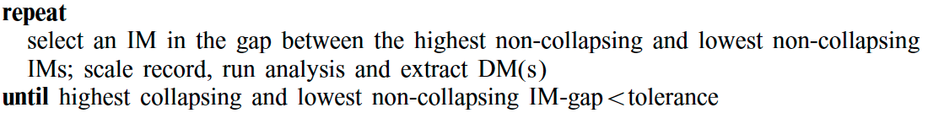

Slide 23
Furthermore, to improve upon the capacity resolution, a simple enhancement is to add a step-reducing routine, for example bisection, when collapse (e.g. non-convergence) is detected, so as to tighten the bracketing of the flatline.
This will enable a prescribed accuracy for the capacity to be reached regardless of the demand resolution.

Slide 24
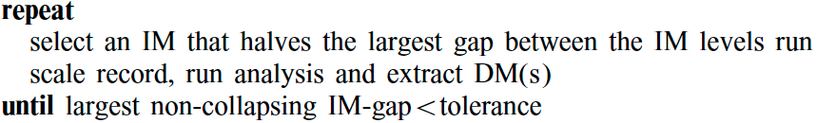

Slide 25
CONCLUSIONS
PROPERTIES
LEGITIMACY
ALGORITHMS
Discontinuities, 'flatlining‘, resurrection and
the variability from record to record.
Addressed the question of 'legitimacy' of scaling records and the relationships between IDAs and the SPO Analysis.
Algorithms presented here can reduce the number of non-linear runs per record to a handful

Slide 26
Roadmap
02/2016
04/2016
06/2016
Market Overview
Pre-Release
Launch
01/2016
03/2016
05/2016
Introduction
Partnerships
Beta

Slide 27

The problem you want to solve

Slide 28



Today’s solutions

Slide 29
Why it doesn’t work
Difficult to implement
Expensive for small businesses
Zero customization

Slide 30

Your solution

Slide 32
Your solution

Slide 33
Your solution

Slide 34
Your solution

Slide 36
Your solution

Slide 37
Awesome features
Awesome map feature
Awesome like feature
Awesome battery feature

Slide 38
Use case
1
2
3
4
5
Very Easy Step 1
Very Easy Step 2
Very Easy Step 3
Very Easy Step 4
Very Easy Step 5

Slide 39
Value Proposal
Make things really change
Make the world a better place
Offer one perfect answer
This is how we are going to make this happen in a beautiful way.
This is how we are going to make this happen in a beautiful way.
This is how we are going to make this happen in a beautiful way.

Slide 40
Market Sizing
$36b
$12b
$2b
Total World Market
Total US Market
Total FR Market
Source : source.io
Source : source.io
Source : source.io

Slide 41
Market Size over Time
Market Sizing (in €billions)

Slide 42
Market on Map
$1b
$2b

Slide 43
Why Now ?
Mobile Internet Usage

Slide 44


Customer Profiles
Young adults
25-35 years old
Students
15-20 years old

Slide 45
Competitors

Slide 46
AXIS 2
Your company
competitor
competitor
AXIS 1
AXIS 1
competitor
competitor
competitor
competitor
AXIS 2

Slide 47
 | YOUR COMPANY | COMPETITOR 1 | COMPETITOR 2 | COMPETITOR 3
feature 1
feature 2
feature 3
feature 4
feature 5
feature 6

Slide 48
Metrics
800
97%
94%
Paying users
Margin
Recurring users
$150,000
85,000
54
Monthly Recurring
Revenue
Users growing 45% per month
API Integrations

Slide 49
Conversion Rate
0,27%

Slide 50
Split Budget

Slide 51
Split Budget
75%
69%
30%
29%
29%
Marketing
Research
Sales
Design
Hiring

Slide 52
Forecast

Slide 53
Financial Table
 | 2016 | 2017 | 2018 | 2019 | 2020
Sales | 0 | 50 | 400 | 1000 | 3000
Revenue | - | $100 000 | $800 000 | $2 000 000 | $6 000 000
Gross Margin (%) | - | 49% | 51% | 53% | 58%
Expenses | - | $128 000 | $450 000 | $800 000 | $1 200 000
Net Profit | - | $-28,000 | $350 000 | $1 200 000 | $4 800 000
Profit Margin (%) | - | -28% | 44% | 60% | 80%

Slide 54
Outstanding Founders
Dave Lopper CTO
Come Mertial CEO
Tran Zition
CPO
Google
Facebook
Stanford
Microsoft
SalesForce
HEC Paris
Uber
Awwwards
MIT Media Lab

Slide 55
Advisors and Directors
Jérémy Vestiaire
Financial Advisor
Goldman Sachs
Jey Bestelgram
Product Advisor
Amazon
Oudam Dadam
Machine Learning Enthousiast
SpaceX
Tomy Lamousse
PR Advisor
Mashable
Lam Ontarelle
UX Contributor
Slidor
Renaude Yorella
Board Member
Sequoia Capital
Laurence Marc
Board Member
Accel Partners
Vince Lacluze
UI Director
Snapchat

Slide 56
Roadmap
02/2016
04/2016
06/2016
Market Overview
Pre-Release
Launch
01/2016
03/2016
05/2016
Introduction
Partnerships
Beta

Slide 57
Say you want to make the world a better place

Slide 58
Icons

Slide 59
Icons

Slide 60
Social

Slide 61
Red
Pink
Purple
Deep Purple
Indigo
Blue
Light Blue
Cyan
Teal
Green
Light Green
Lime
Yellow
Amber
Orange
Deep Orange
50
50
50
50
50
50
50
50
50
50
50
50
50
50
50
50
100
100
100
100
100
100
100
100
100
100
100
100
100
100
100
100
200
200
200
200
200
200
200
200
200
200
200
200
200
200
200
200
300
300
300
300
300
300
300
300
300
300
300
300
300
300
300
300
400
400
400
400
400
400
400
400
400
400
400
400
400
400
400
400
500
500
500
500
500
500
500
500
500
500
500
500
500
500
500
500
600
600
600
600
600
600
600
600
600
600
600
600
600
600
600
600
700
700
700
700
700
700
700
700
700
700
700
700
700
700
700
700
800
800
800
800
800
800
800
800
800
800
800
800
800
800
800
800
900
900
900
900
900
900
900
900
900
900
900
900
900
900
900
900
A100
A100
A100
A100
A100
A100
A100
A100
A100
A100
A100
A100
A100
A100
A100
A100
A200
A200
A200
A200
A200
A200
A200
A200
A200
A200
A200
A200
A200
A200
A200
A200
A400
A400
A400
A400
A400
A400
A400
A400
A400
A400
A400
A400
A400
A400
A400
A400
A700
A700
A700
A700
A700
A700
A700
A700
A700
A700
A700
A700
A700
A700
A700
A700

Slide 62
Gradient 1

Slide 63
Gradient 2

Slide 64
Gradient 3

Slide 65
Gradient 4

Slide 66
Gradient 5

